Slide 1
TITLE: AIRCRAFT BIRD STRIKES DASHBOARD
UNIFIED MENTOR

Slide 2
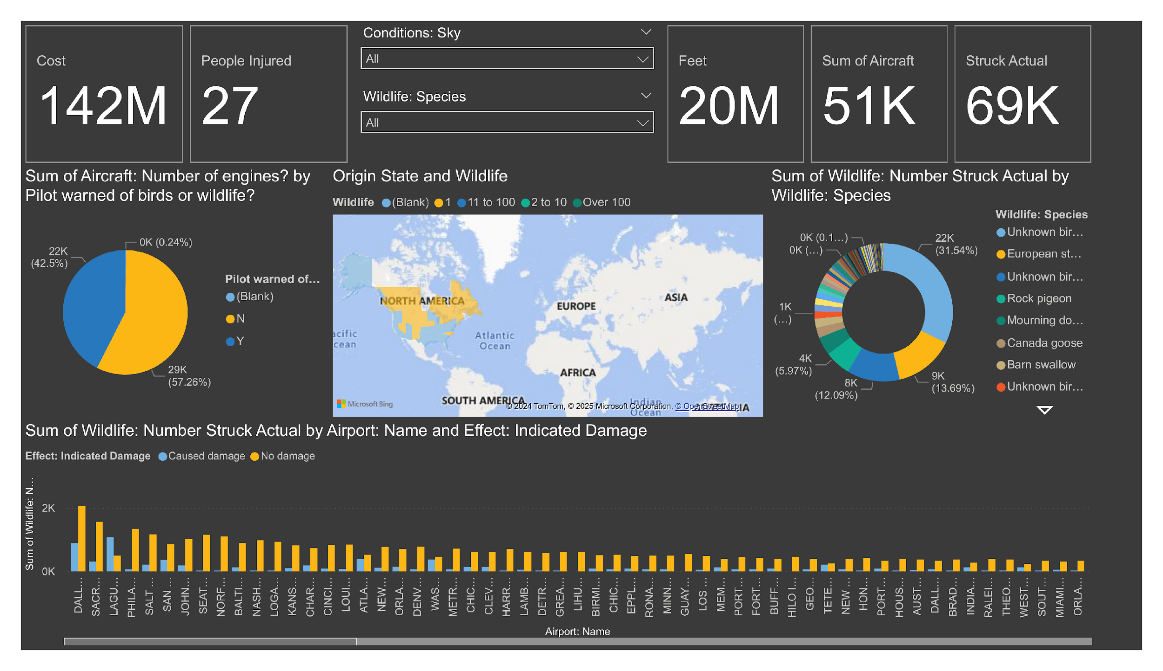
DASHBOARD
PAGE 1

Slide 3
AIRCRAFT ENGINE TYPE AND PILOT CHART CONTENT: DISPLAYS THE RELATIONSHIP BETWEEN THE NUMBER OF AIRCRAFT ENGINES AND WHETHER PILOTS WERE WARNED ABOUT WILDLIFE.
INSIGHTS: A SIGNIFICANT PERCENTAGE OF WILDLIFE STRIKES OCCURRED WITHOUT PRIOR WARNINGS TO PILOTS. TWO-ENGINE AIRCRAFT SEEM TO DOMINATE IN THESE CASES.

Slide 4
WILDLIFE STRIKES BY AIRPORT AND DAMAGE CHART CONTENT: HIGHLIGHTS THE DISTRIBUTION OF WILDLIFE STRIKES ACROSS AIRPORTS AND THE DAMAGE CAUSED.
INSIGHTS: MAJOR AIRPORTS LIKE DALLAS AND SACRAMENTO SHOW A HIGHER NUMBER OF INCIDENTS. STRIKES CAUSING DAMAGE ARE LESS FREQUENT THAN THOSE CAUSING NO DAMAGE.

Slide 5
WILDLIFE STRIKES BY SPECIES
CHART CONTENT: SHOWS THE SPECIES INVOLVED IN WILDLIFE STRIKES AND THEIR FREQUENCY.
INSIGHTS: MOST STRIKES INVOLVE UNIDENTIFIED BIRD SPECIES, FOLLOWED BY EUROPEAN STARLINGS AND ROCK PIGEONS. LARGER SPECIES, SUCH AS CANADA GEESE, ARE A SIGNIFICANT CONCERN.

Slide 6
COST OF WILDLIFE STRIKES BY FLIGHT IMPACT CHART CONTENT: ANALYZES COSTS ASSOCIATED WITH VARIOUS FLIGHT IMPACTS LIKE PRECAUTIONARY LANDINGS OR ABORTED TAKE-OFFS.
INSIGHTS: PRECAUTIONARY LANDINGS ACCOUNT FOR THE HIGHEST COSTS, FOLLOWED BY ENGINE SHUTDOWN INCIDENTS. MINIMAL COSTS ARE ASSOCIATED WITH ABORTED TAKE-OFFS.

Slide 7
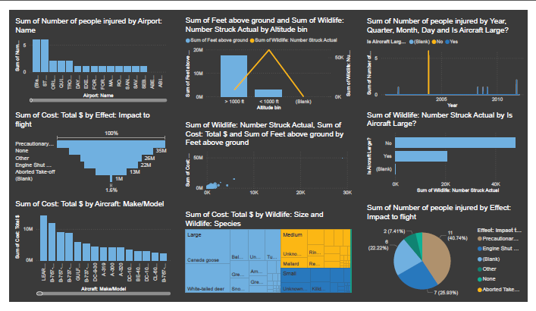
PAGE 2

Slide 8
ACTIONABLE INSIGHTS
TARGETED MITIGATION: AIRPORTS WITH HIGHER STRIKE FREQUENCIES SHOULD FOCUS ON WILDLIFE MANAGEMENT STRATEGIES LIKE HABITAT MODIFICATION OR AVIAN RADAR SYSTEMS. STRATEGIES COULD INCLUDE REDUCING ATTRACTANTS (E.G., OPEN WATER OR FOOD SOURCES) NEAR RUNWAYS. DAMAGE MITIGATION: WHILE MOST STRIKES DON'T CAUSE DAMAGE, EFFORTS SHOULD PRIORITIZE PREVENTING STRIKES INVOLVING LARGER SPECIES, AS THEY ARE MORE LIKELY TO RESULT IN DAMAGE. DATA-DRIVEN PRIORITIZATION: ALLOCATE RESOURCES TO HIGH-RISK AIRPORTS AND TIMES (SEASONAL MIGRATIONS) TO ENHANCE PREVENTATIVE MEASURES.

